Slide 1
SOCIAL NETWORK ANALYSIS

Slide 2
Background
SNA - Social Network Analysis - focus on the relationships established between social entities (individuals, groups,etc.) rather in the social entities themselves
SNA has its origins in both social science and in the broaden fields of Network Analysis and Graph Theory (Giorgos Cheliotis, 2010)
Social Science
Source of the theoretical questions and problems that involve explaining the social behavior by means of the analysis of the network structure of societies
Network
Analysis
Graph Theory
SNA
Focus is on the formulation and solution of problems that have an underlying network structure
Mathematical field that provides a set of abstract concepts and methods for the representation and analysis of graphs
Interdisciplinary
field

Slide 3
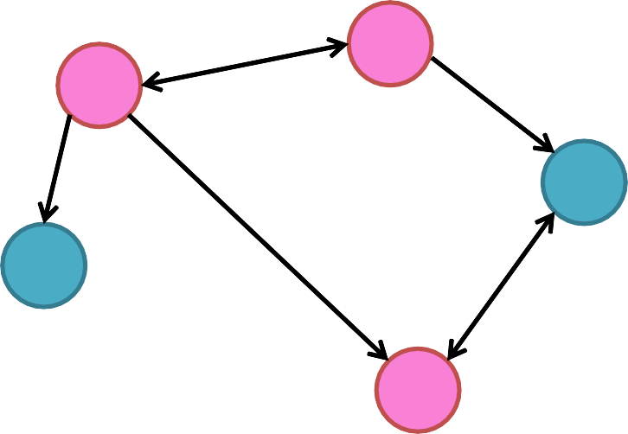
Background
Definition of social network (SN): a social network consists of a finite set(s) of actors and the relations (ties) defined on them (Wasserman and Faust, 1994).
Daniela
Actors/Agents:
Maria
Daniela
João
Ana
Diogo
Maria
Edges
Vertices
João
Graph
Diogo
Ties:
- Friendship ties
Ana
The relationships can be of personal or profissional nature and can range from casual acquaintance to close familiar bonds
Besides social relations, edges can also represent flow of
information/goods/money, interactions, similarities, among others
The structure of a SN is usually represented resorting to graphs.

Slide 4
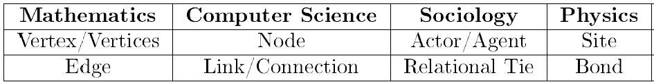
Background
Terminology:
SNA is an interdisciplinary field with contributions from different knowledge areas; such variety of perspectives originated distinct terminology

Slide 5
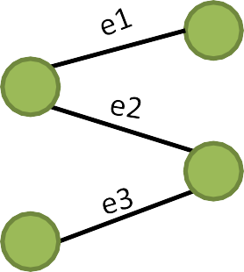
Graph Theory
1. Types and representation of graphs
Unlabeled
Vertex-labeled
Edge-labeled
Vertex and Edge-labeled
Marta
Jorge
Marta
Jorge
Luís
Lara
Luís
Lara
Multigraphs
Hypergraphs
Bipartite Graphs
Multiple edge
loop

Slide 6
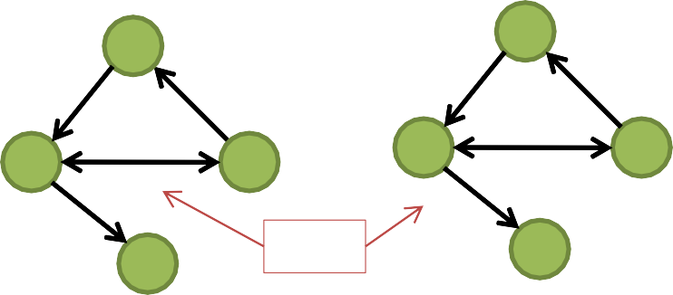
Graph Theory
1. Types and representation of graphs
Undirected graphs
Directed graphs = Digraphs
Unweighted
Weighted
Unweighted
Weighted
A
A
A
A
20
3
10
D
B
_{D} 12 _{B}
7
C
D
B
D
12
B
4
C
C
C
Arcs
If only one direction is allowed then the graph is oriented instead of directed
Digraph D(V,A)
Graph G(V,E) V(G)={A,B,C,D}
Vertex set
V(D)={A,B,C,D}
Vertex set
E(G)={(A,B),(A,D),(B,D),(D,C)}
Edge set
Edge set
A(D)={(A,D), (D,C), (B,A),(B,D),(D,B) }

Slide 7





Graph Theory
1. Types and representation of graphs
Graph representation schemes
List structures
Matrix structures
Incidence lists
Adjacency lists
Incidence matrices Gn.m
Adjacency matrices Gn.n
Laplacian matrices
Distance matrices
Appropriate to store
sparse graphs
Appropriate to represent full
matrices
Undirected graphs
Adjacency List
Adjacency Matrix
Who is friend of whom?
(e.g. Facebook)
A
Vertex | Vertex
A | B
A | D
B | D
C | D
Vertex | A | B | C | D
A | - | 1 | 0 | 1
B | 1 | - | 0 | 1
C | 0 | 0 | - | 1
D | 1 | 1 | 1 | -
D
B
Symmetric
Binary
C

Slide 8
Graph Theory
1. Types and representation of graphs
Directed graphs
Adjacency List
Adjacency Matrix
Who follows
Vertex | Vertex
A | D
B | A
B | D
D | B
D | C
Vertex | A | B | C | D
A | - | 0 | 0 | 1
B | 1 | - | 0 | 1
C | 0 | 0 | - | 0
D | 0 | 1 | 1 | -
A
whom?
(e.g. Twitter)
Non-symmetric
Binary
D
B
C
Weighted graphs
Adjacency List
Adjacency Matrix
A
Vertex | Vertex | Weight
A | D | 3
B | A | 10
B | D | 12
D | B | 12
D | C | 4
Vertex | A | B | C | D
A | - | 0 | 0 | 3
B | 10 | - | 0 | 12
C | 0 | 0 | - | 0
D | 0 | 12 | 4 | -
3
10
D
12
B
4
C

Slide 9
Adding weights to edges (directed or undirected)
30
Edge list: add column of weights
1
Vertex | Vertex | Weight
1 | 2 | 30
1 | 3 | 5
2 | 3 | 22
2 | 4 | 2
3 | 4 | 37
2
22
5
2
3
4
37
Weights could be:
Frequency of interaction in period of observation
Number of items exchanged in period
Individual perceptions of strength of relationship
Costs in communication or exchange, e.g. distance
Adjacency matrix: add weights instead of 1
Vertex | 1 | 2 | 3 | 4
1 | - | 30 | 5 | 0
2 | 30 | - | 22 | 2
3 | 5 | 22 | - | 37
4 | 0 | 2 | 37 | -

Slide 10

Edge weights as relationship strength
Edges can represent interactions, flows of information or goods, similarities/affiliations, or social relations
Specifically for social relations, a ‘proxy’ for the strength of a tie can be:
the frequency of interaction (communication) or the amount of flow (exchange)
the type of interaction or flow between the two parties (e.g., intimate or not)
other attributes of the nodes or ties (e.g., family relationships)
The structure of the nodes’ neighborhood (e.g. many mutual ‘friends’)

Slide 11
Tie Strength
Defined by the linear combination of time, emotional intensity, intimacy and reciprocity (i.e. mutuality).
Strong ties
Associated with homophily, and transitivity.
Weak ties
Associated with heterogeneity and bridges.

Slide 12
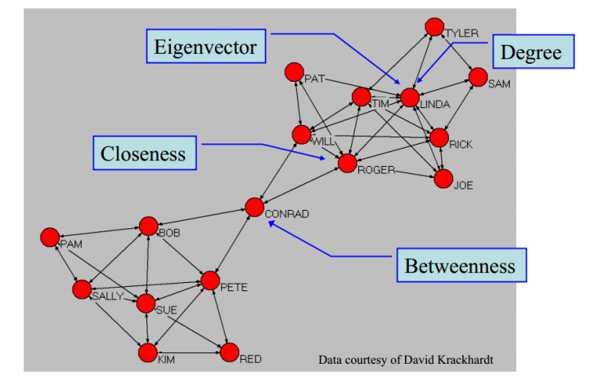

Slide 13
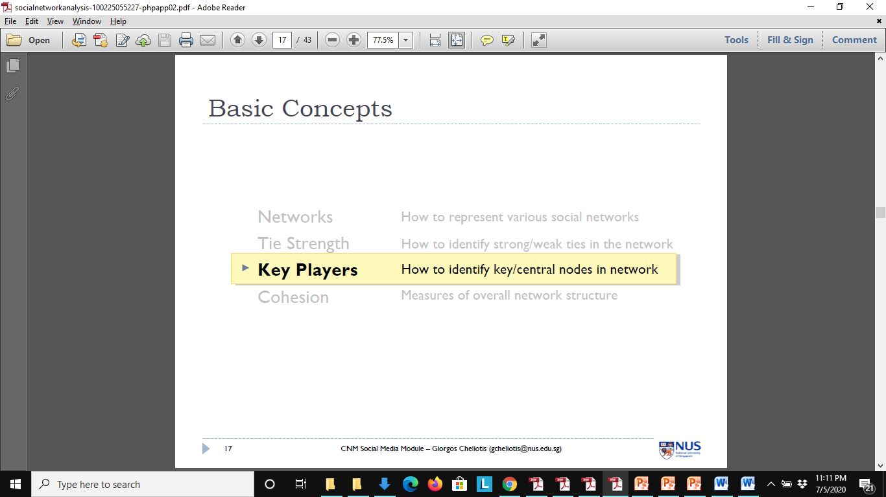
Fundamental concepts in network analysis

Slide 14
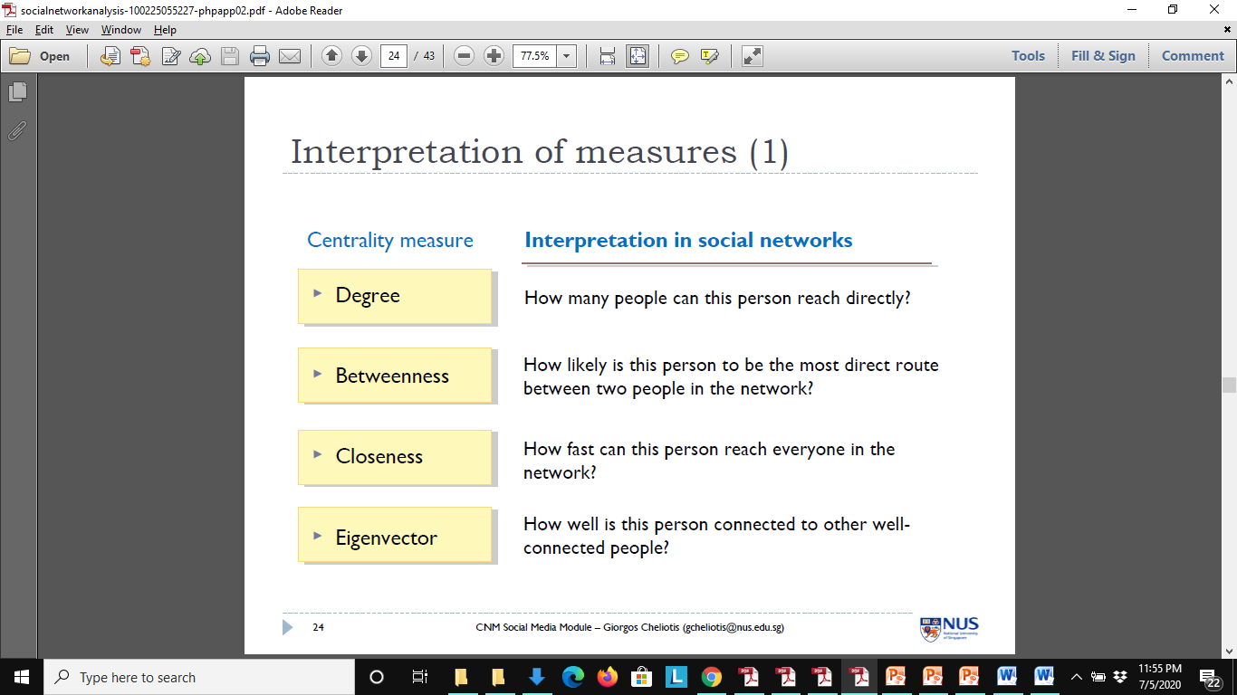
Interpretation of measures (1)

Slide 15
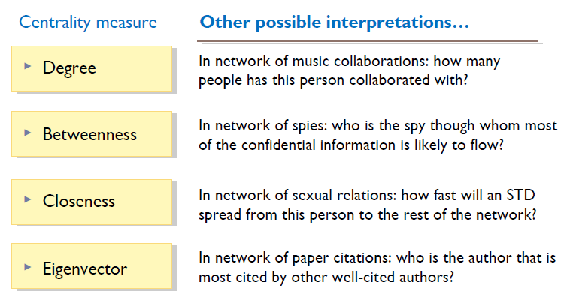
Interpretation of measures (2)

Slide 16
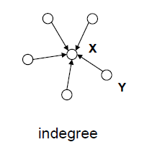
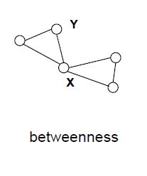
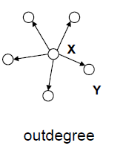
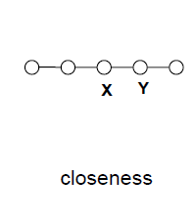
Centrality – Who is most important based on the position

Slide 17
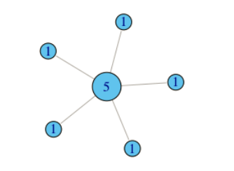
Degree Centrality
When is the number of connections the best centrality measure
People who will do favor for you
People you can talk to /coffee with you

Slide 18
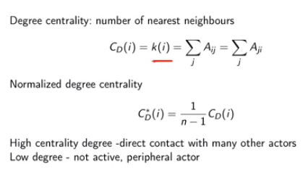
Degree: Normalized Degree Centrality
Degree Divide by the max possible i.e N-1

Slide 19
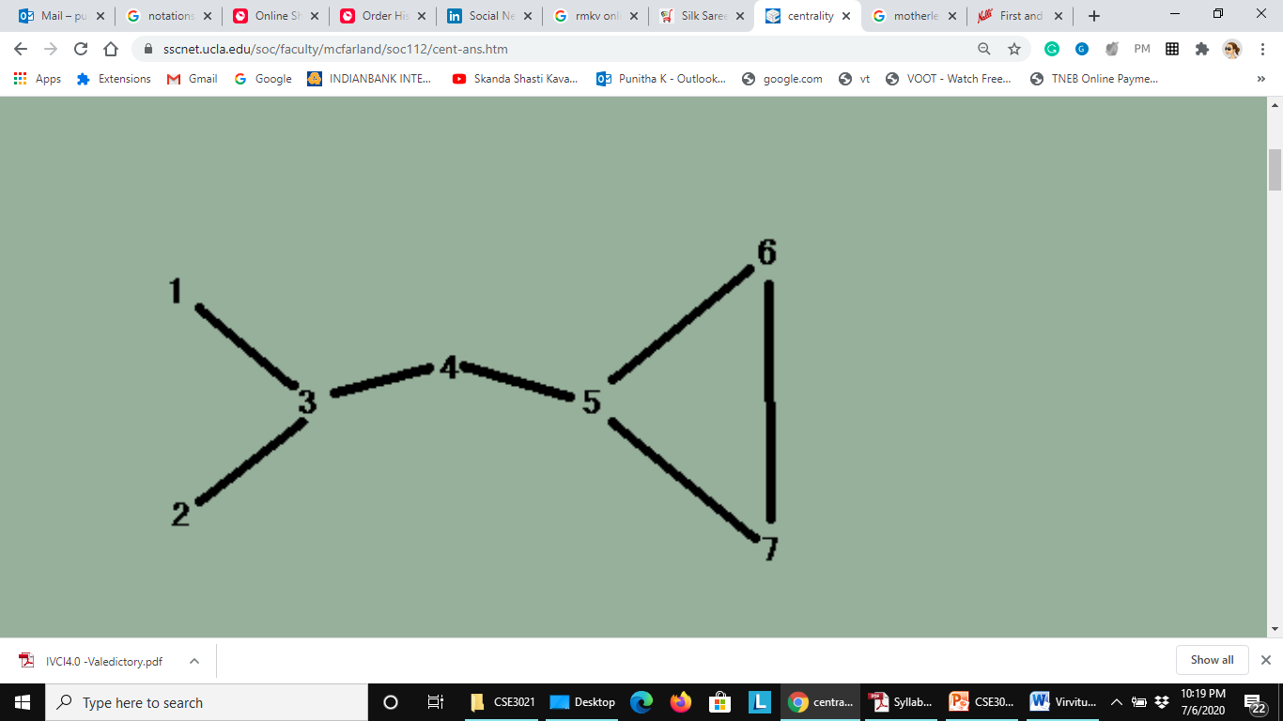
Degree centrality Exercise
Degree centrality of a node refers to the number of edges attached to the node.
In order to know the standardized score, you need to divide each score by n-1 (n = the number of nodes). Since the graph has 7 nodes, 6 (7-1) is the denominator for this question.
Degree(vertex)/N-1
N=no. of vertices in the given network

Slide 20
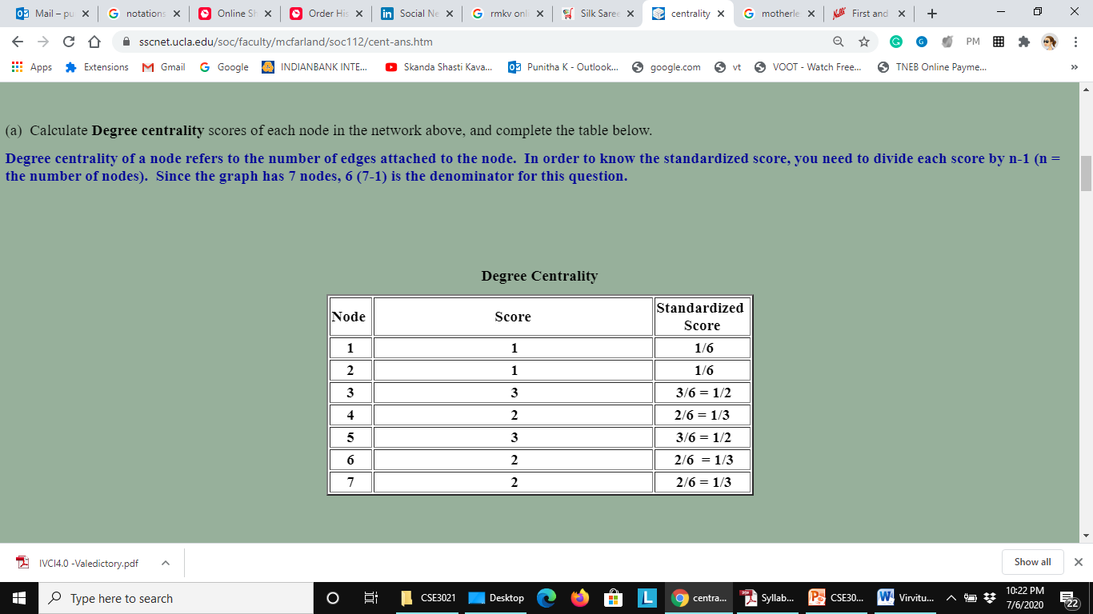
Degree centrality Exercise

Slide 21
Closeness centrality
Closeness centrality is a useful measure that estimates how fast the flow of information would be through a given node to other nodes.
Measure of reachability that gives an idea about how long it will take to reach other nodes from a given starting node
Closeness centrality measures how short the shortest paths are from node i to all nodes.

Slide 22
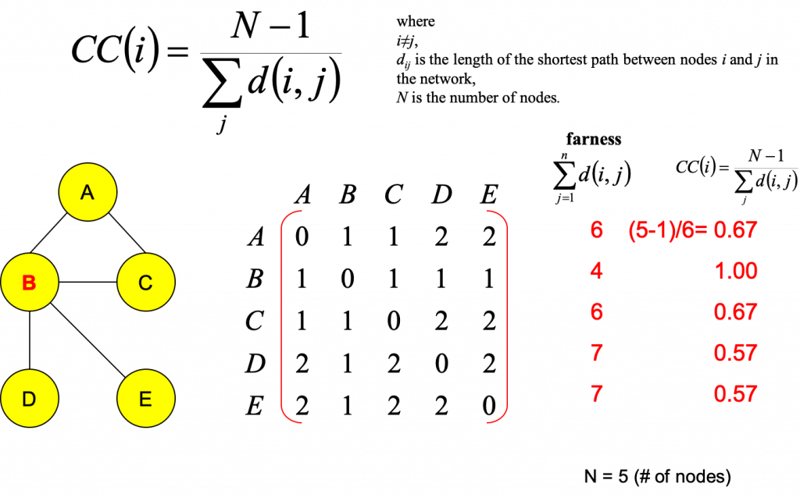

Slide 23
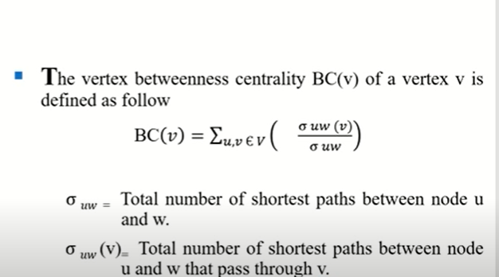
BETWEENNESS CENTRALITY OF VERTEX

Slide 24
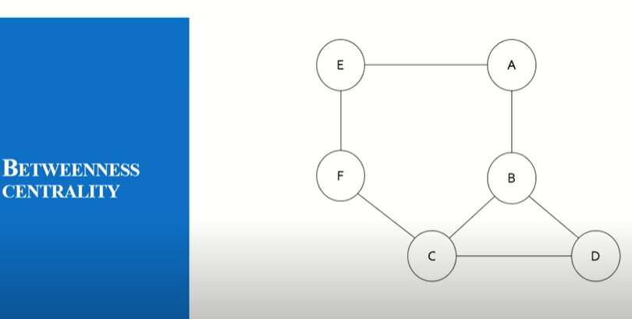
Find Betweeness Centrality of Given Graph

Slide 25
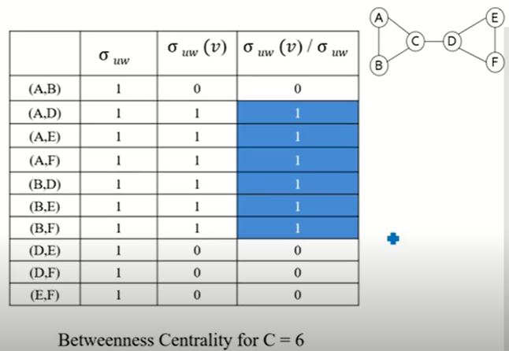
Vertex “C”

Slide 26
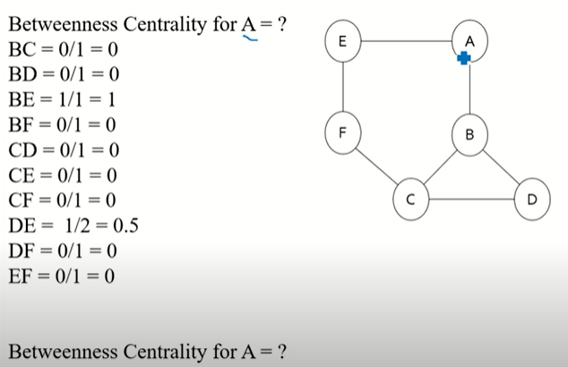

Slide 27
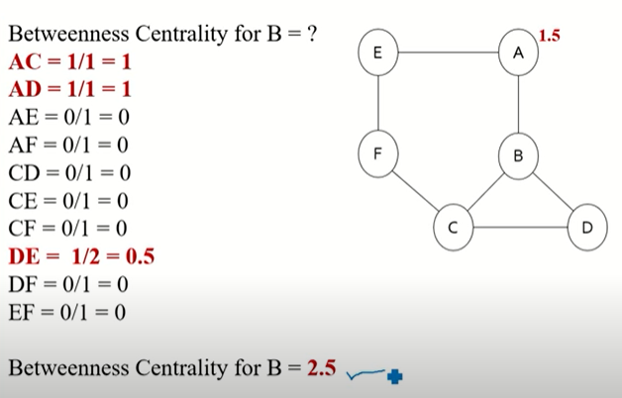

Slide 28
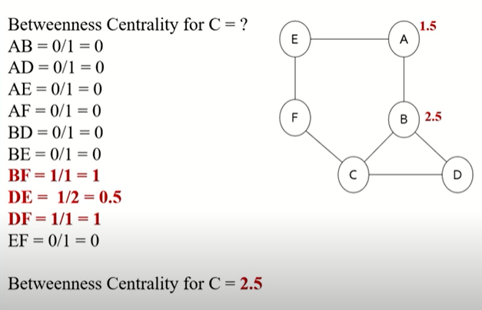

Slide 29
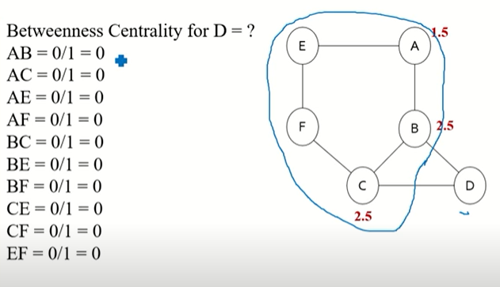

Slide 30
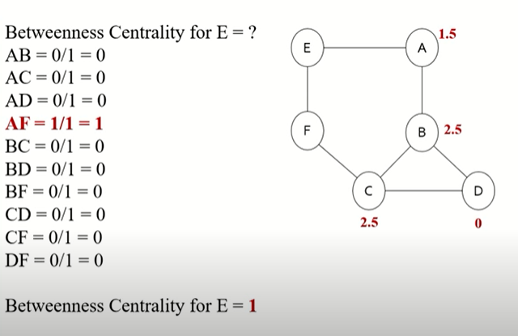

Slide 31
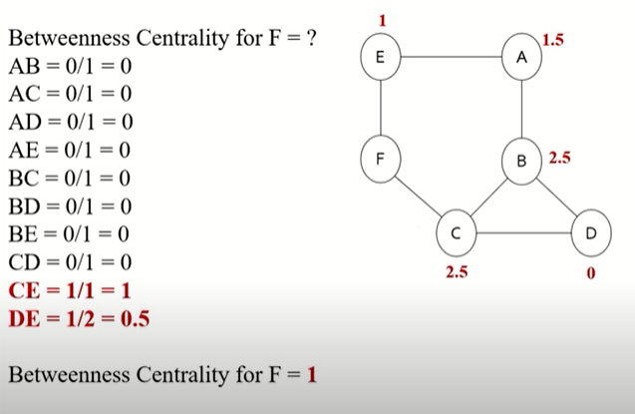

Slide 32
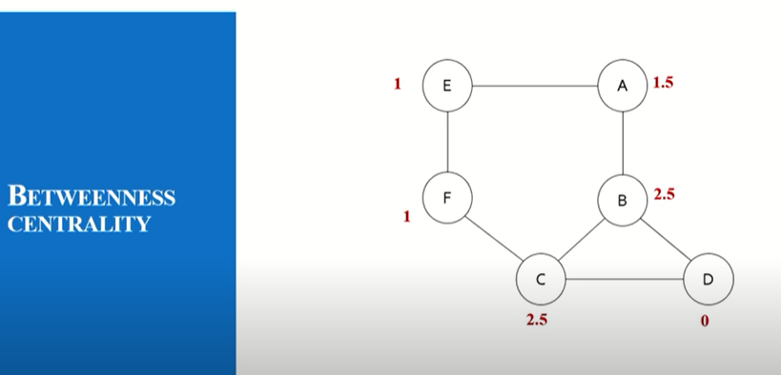

Slide 33
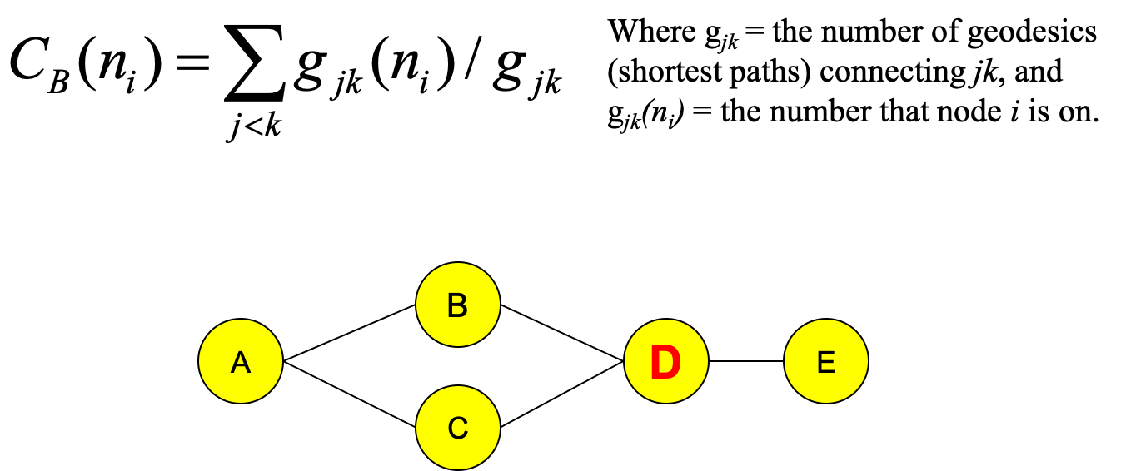
Betweenness centrality measures how often a node occurs on all shortest paths between two nodes.

Slide 34
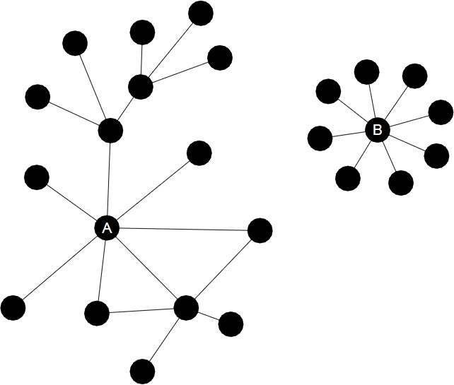
EIGEN VECTOR CENTRALITY
Eigenvector Centrality
This metric is based on the idea that the power and status of an actor is recursively defined by the power and status of his/her alters (or neighbors)
The eigenvector of a node is proportional to the sum of the eigenvector centralities
of all its direct neighbors
It measures how well a given actor is connected to other well-connected actors
Degree VS Eigenvector centrality: eigenvector centrality is a more elaborated version of the degree, once it assumes that not all connections have the same importance by taking into
account not only especially
the quantity, but the quality of these
Actor A has higher eigenvector centrality than actor B
connections.

Slide 35
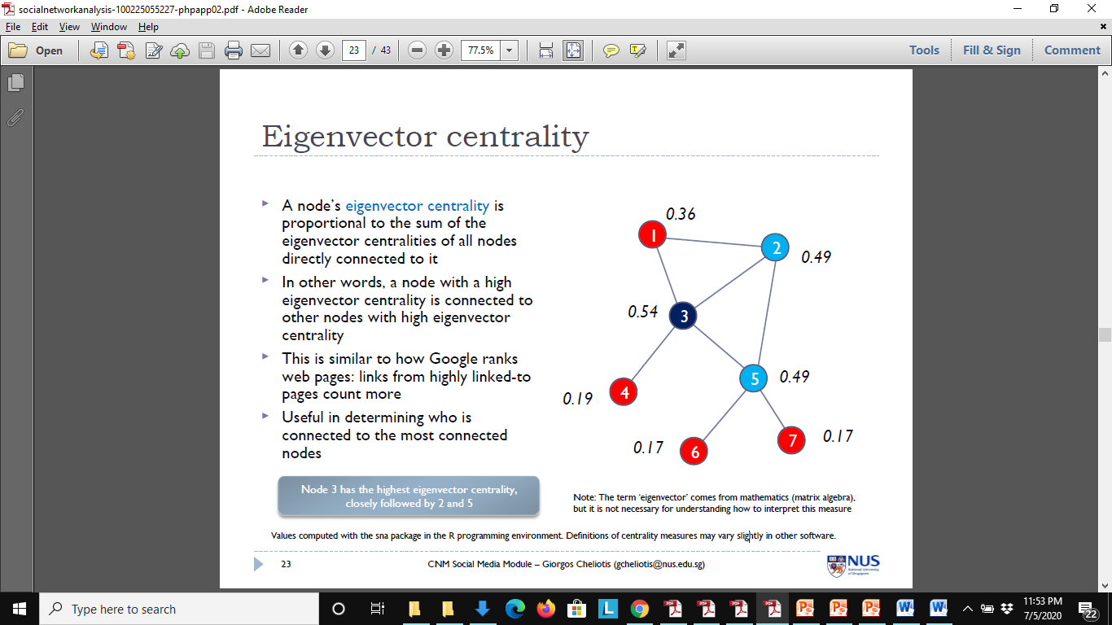
Eigenvector centrality
A node’s eigenvector centrality is proportional to the sum of the eigenvector centralities of all nodes directly connected to it
In other words, a node with a high eigenvector centrality is connected to other nodes with high eigenvector centrality
This is similar to how Google ranks web pages: links from highly linked-to pages count more
Useful in determining who is connected to the most connected nodes.
Node 3 has the highest eigenvector centrality, closely followed by 2 and 5

Slide 36
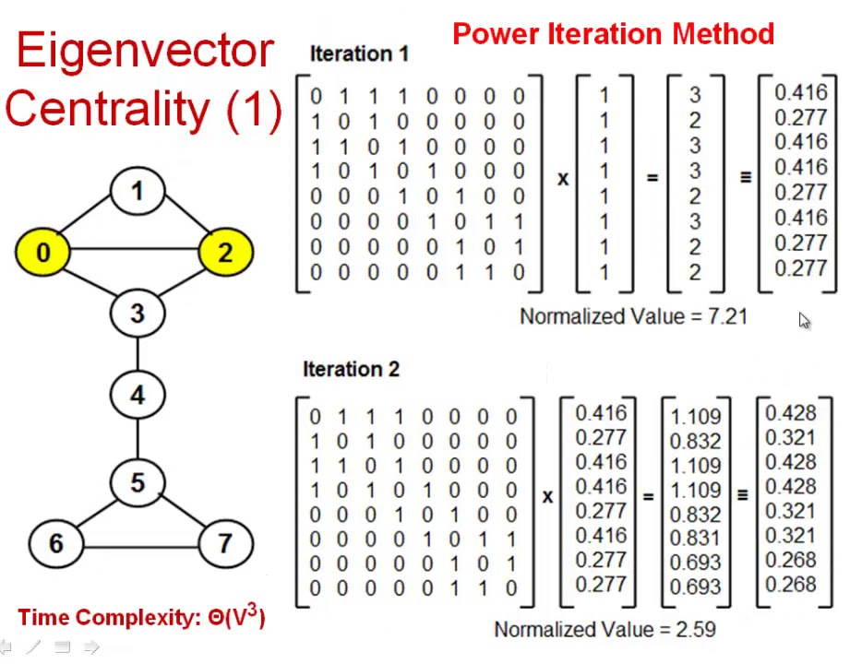

Slide 37
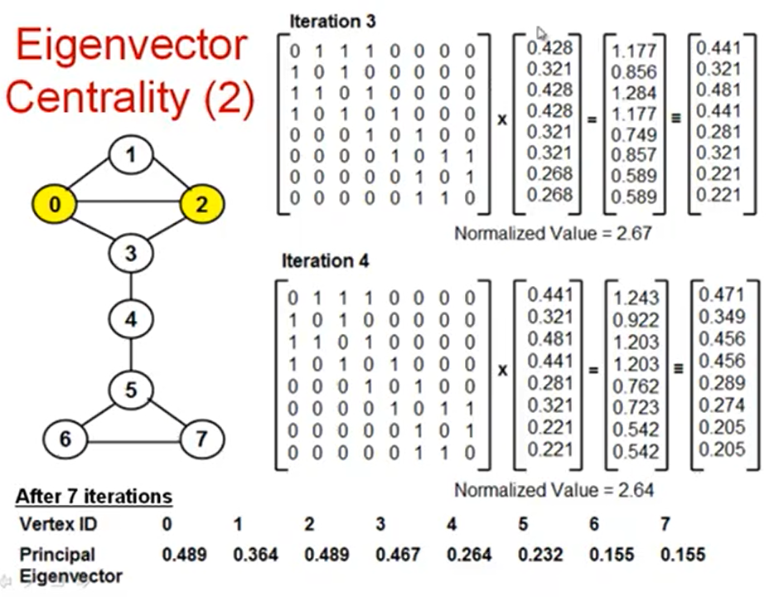

Slide 38
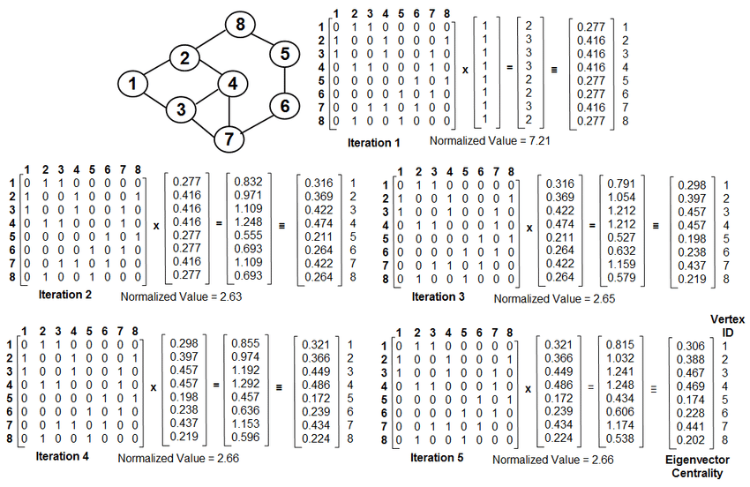

Slide 39
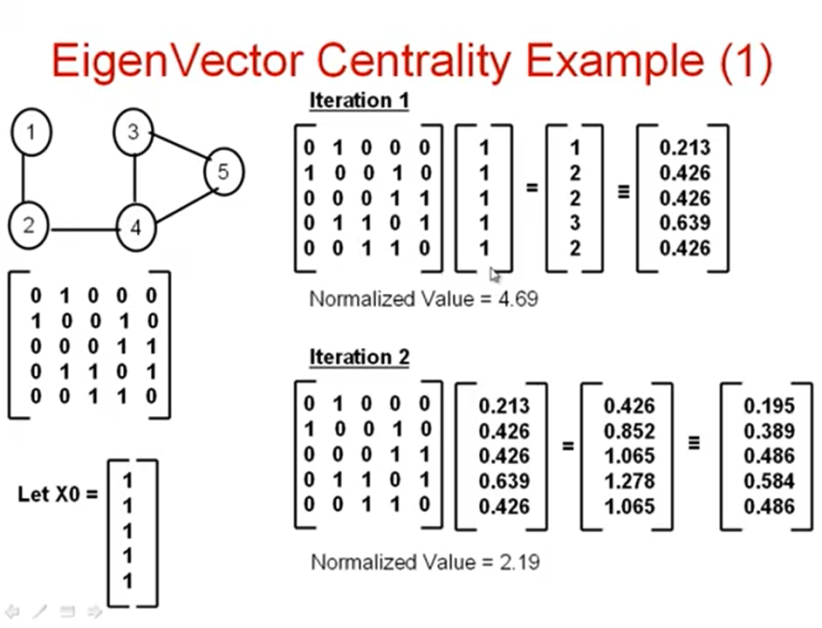

Slide 40
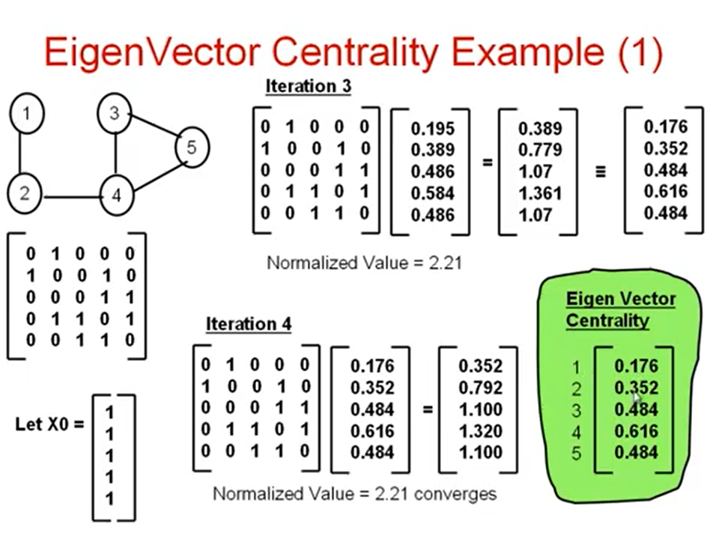

Slide 41
CENTRALITY MEASURES IN DIRECTED GRAPHS

Slide 42
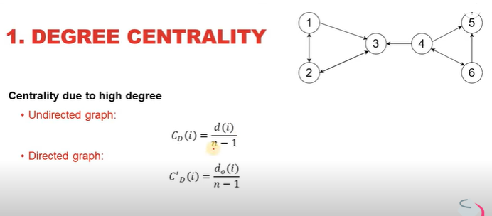
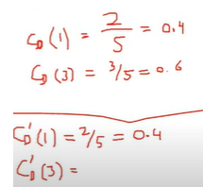
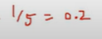

Slide 43
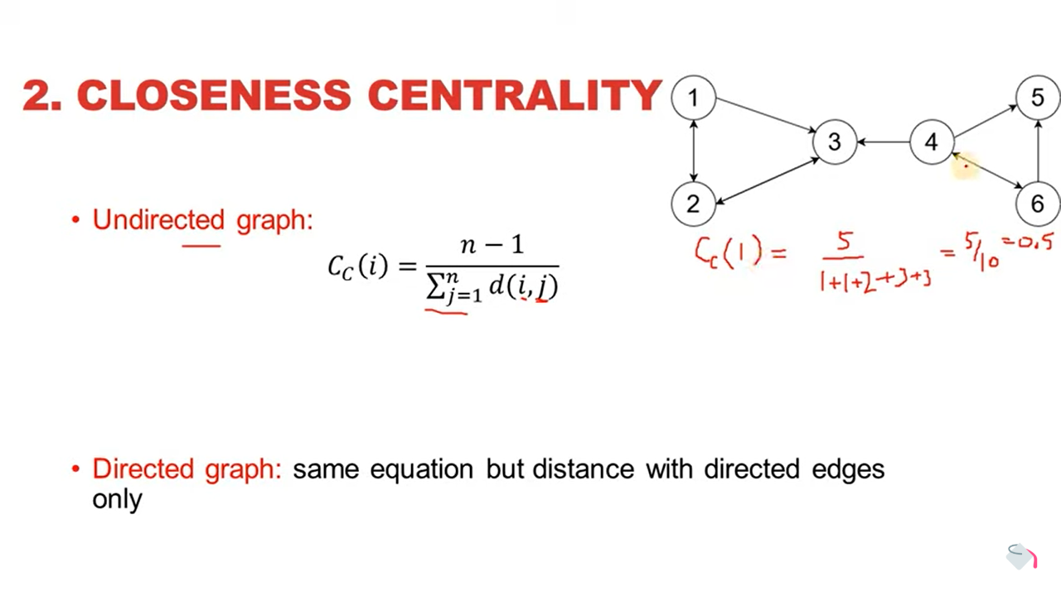

Slide 44
Undirected Graph

Slide 45
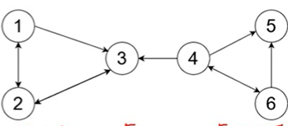
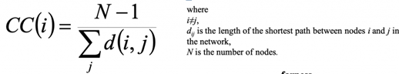
Directed Graph
 | 1 | 2 | 3 | 4 | 5 | 6
1 | 0 | 1 | 1 | -- | -- | --
2 | 1 | 0 | 1 | -- | -- | --
3 | 2 | 1 | 0 | -- | -- | --
4 | 3 | 2 | 1 | 0 | 1 | --
5 | -- | -- | -- | -- | 0 | --
6 | 4 | 3 | 2 | 1 | 1 | 0

Slide 46
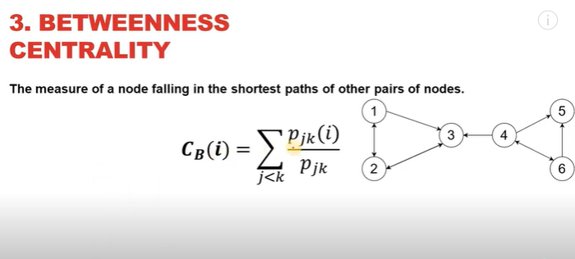

Slide 47
BETWEENNESS CENTRALITY OF VERTEX

Slide 49
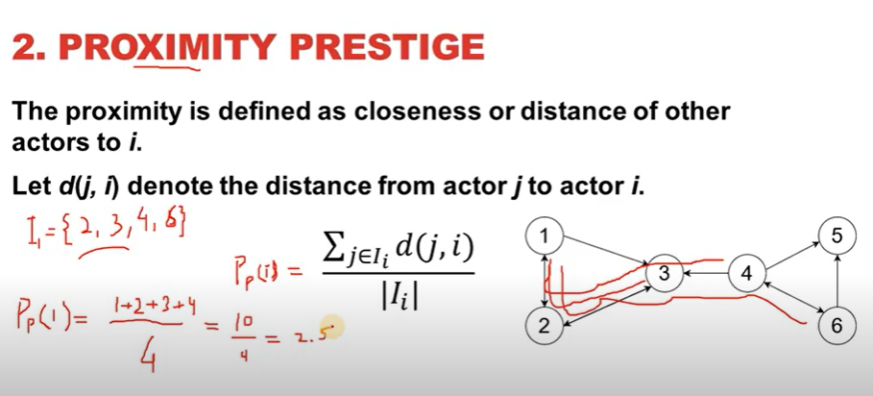

Slide 50
Eigenvector centrality
A node’s eigenvector centrality is proportional to the sum of the eigenvector centralities of all nodes directly connected to it
In other words, a node with a high eigenvector centrality is connected to other nodes with high eigenvector centrality
POWER ITERATION METHOD
MATIRX – EIGEN VALUE & EIGEN VECTORS
A
B
C

Slide 51
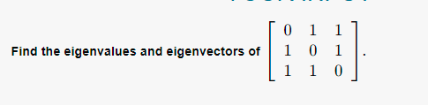
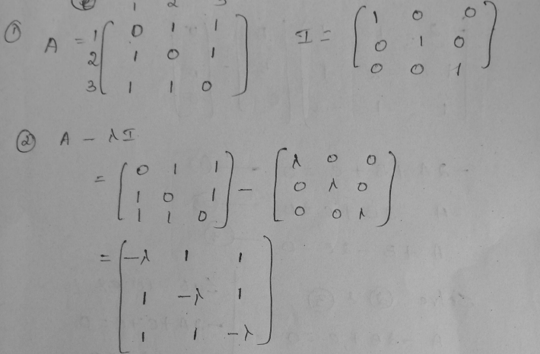
A
B
C

Slide 52
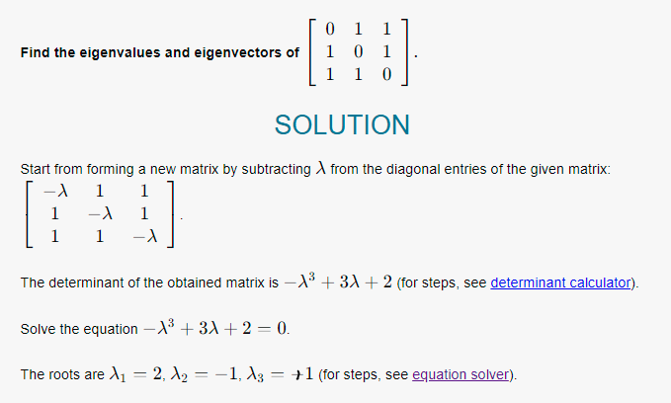
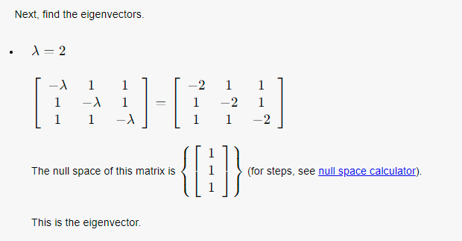
A
B
C

